Slide 1



Global air pollution modelling
University of Utrecht, The Netherlands
Global and geo-health data center
Meng Lu

Slide 2

Goal: Global, high spatial and temporal resolution NO₂ mapping NO₂: is part of a group of gaseous air pollutants produced as a result of road traffic and other fossil fuel combustion processes.

Slide 3
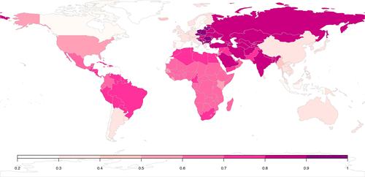
Why global?
Estimation of global burden of disease
to monitor the UN established Sustainable Development Goals
Consistent epidemiological studies world-wide
Inequality in health and air pollution monitors in middle and low income countries
Shaddock et al., 2018

Slide 4

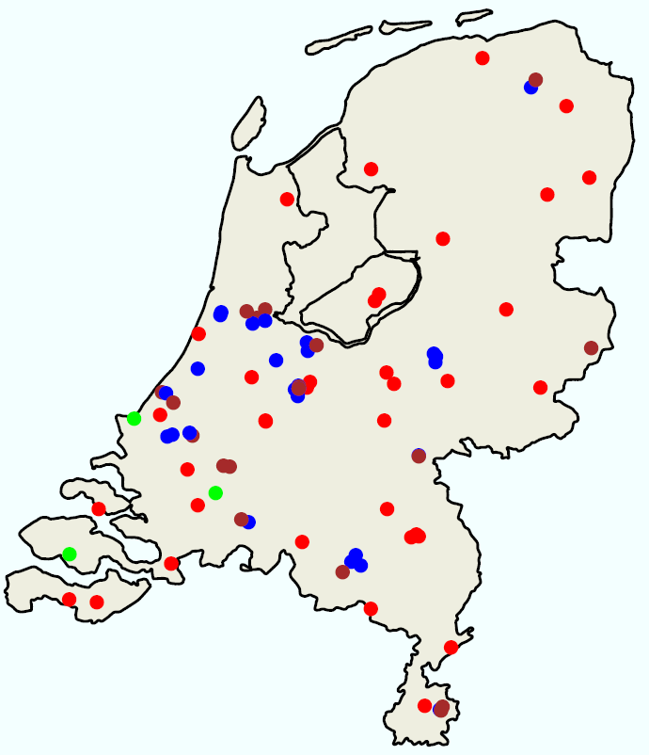
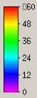

Why high spatial and temporal resolutions?
60
30
RURAL
TRAFFIC
INDUSTRY
Hourly/minutes
LML data (landelijk meetnet luchtkwaliteit)
0
Hour
0
5km

Slide 5
Air pollution modelling methods
Process-based models:
Air dispersion models
Chemical transportation models
Statistical-based methods:
Information form predictors, spatiotemporal dependence.

Slide 6
Geospatial predictors
Road and industrial area from OpenStreetMap (vector)
Earth nightlight (500 m)
as a proxy for socio-demographics
Population (100 m)
From human settlement layers
Climate:Wind speed and temperature
Elevation: SRTM (90 m)

Slide 7
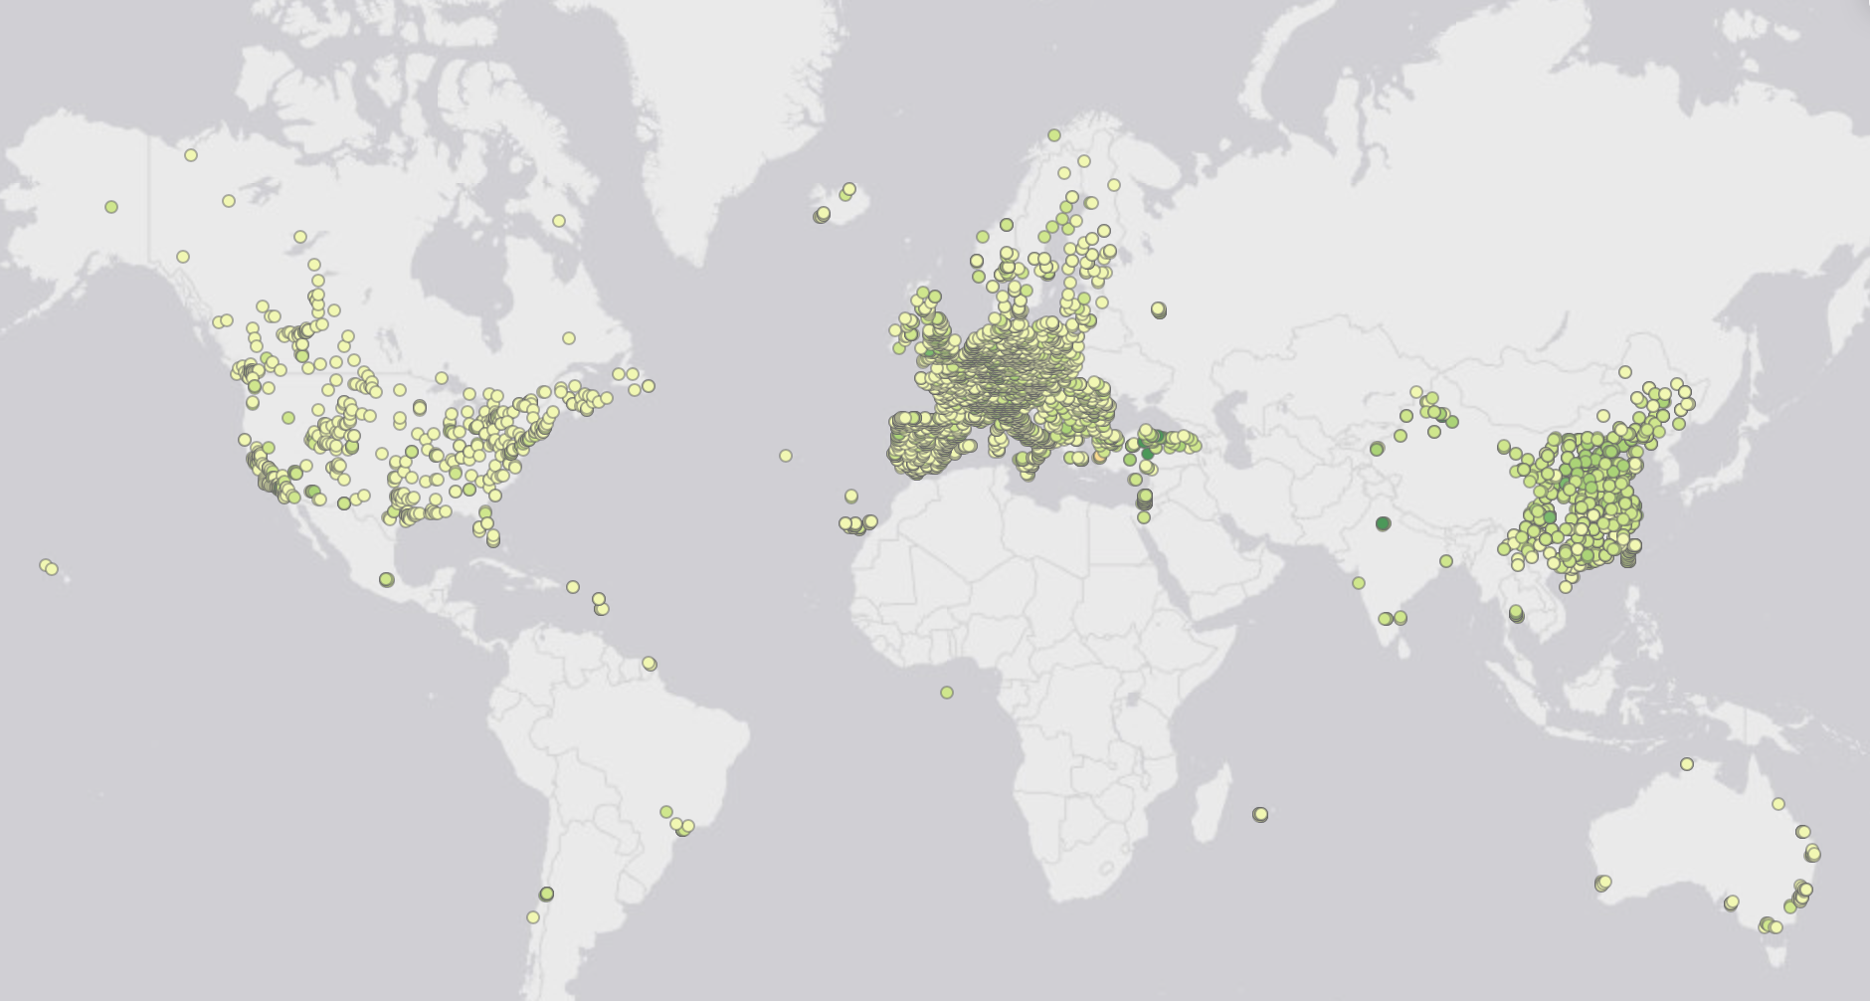
Ground monitor measurements:
OpenAQ: an open science air quality community
Additional data from China, Australia, Canada, US, EU

Slide 8
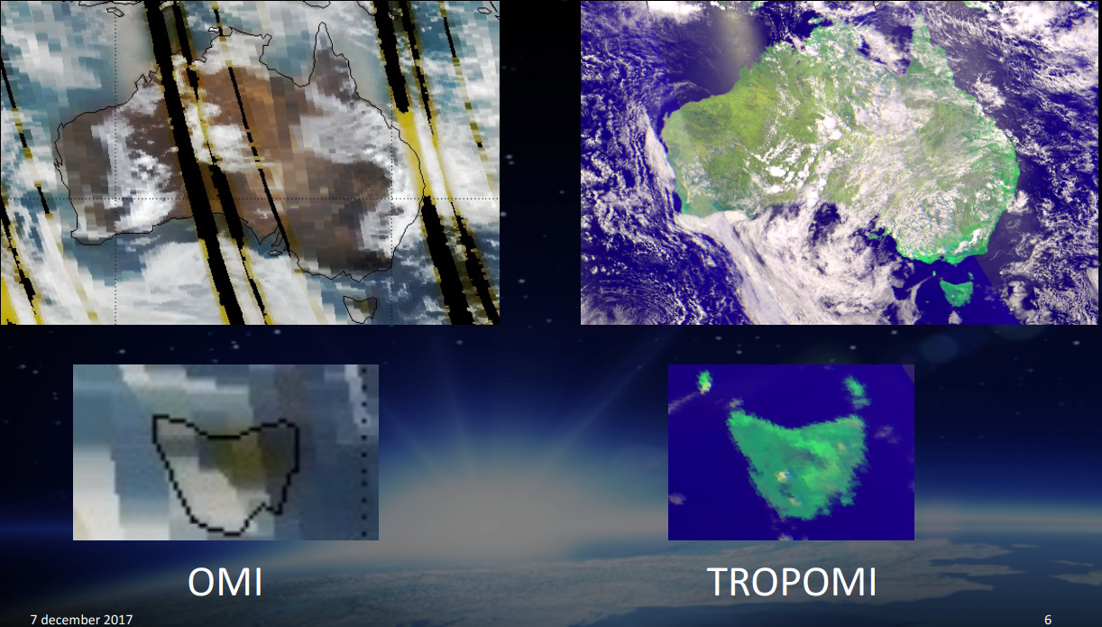
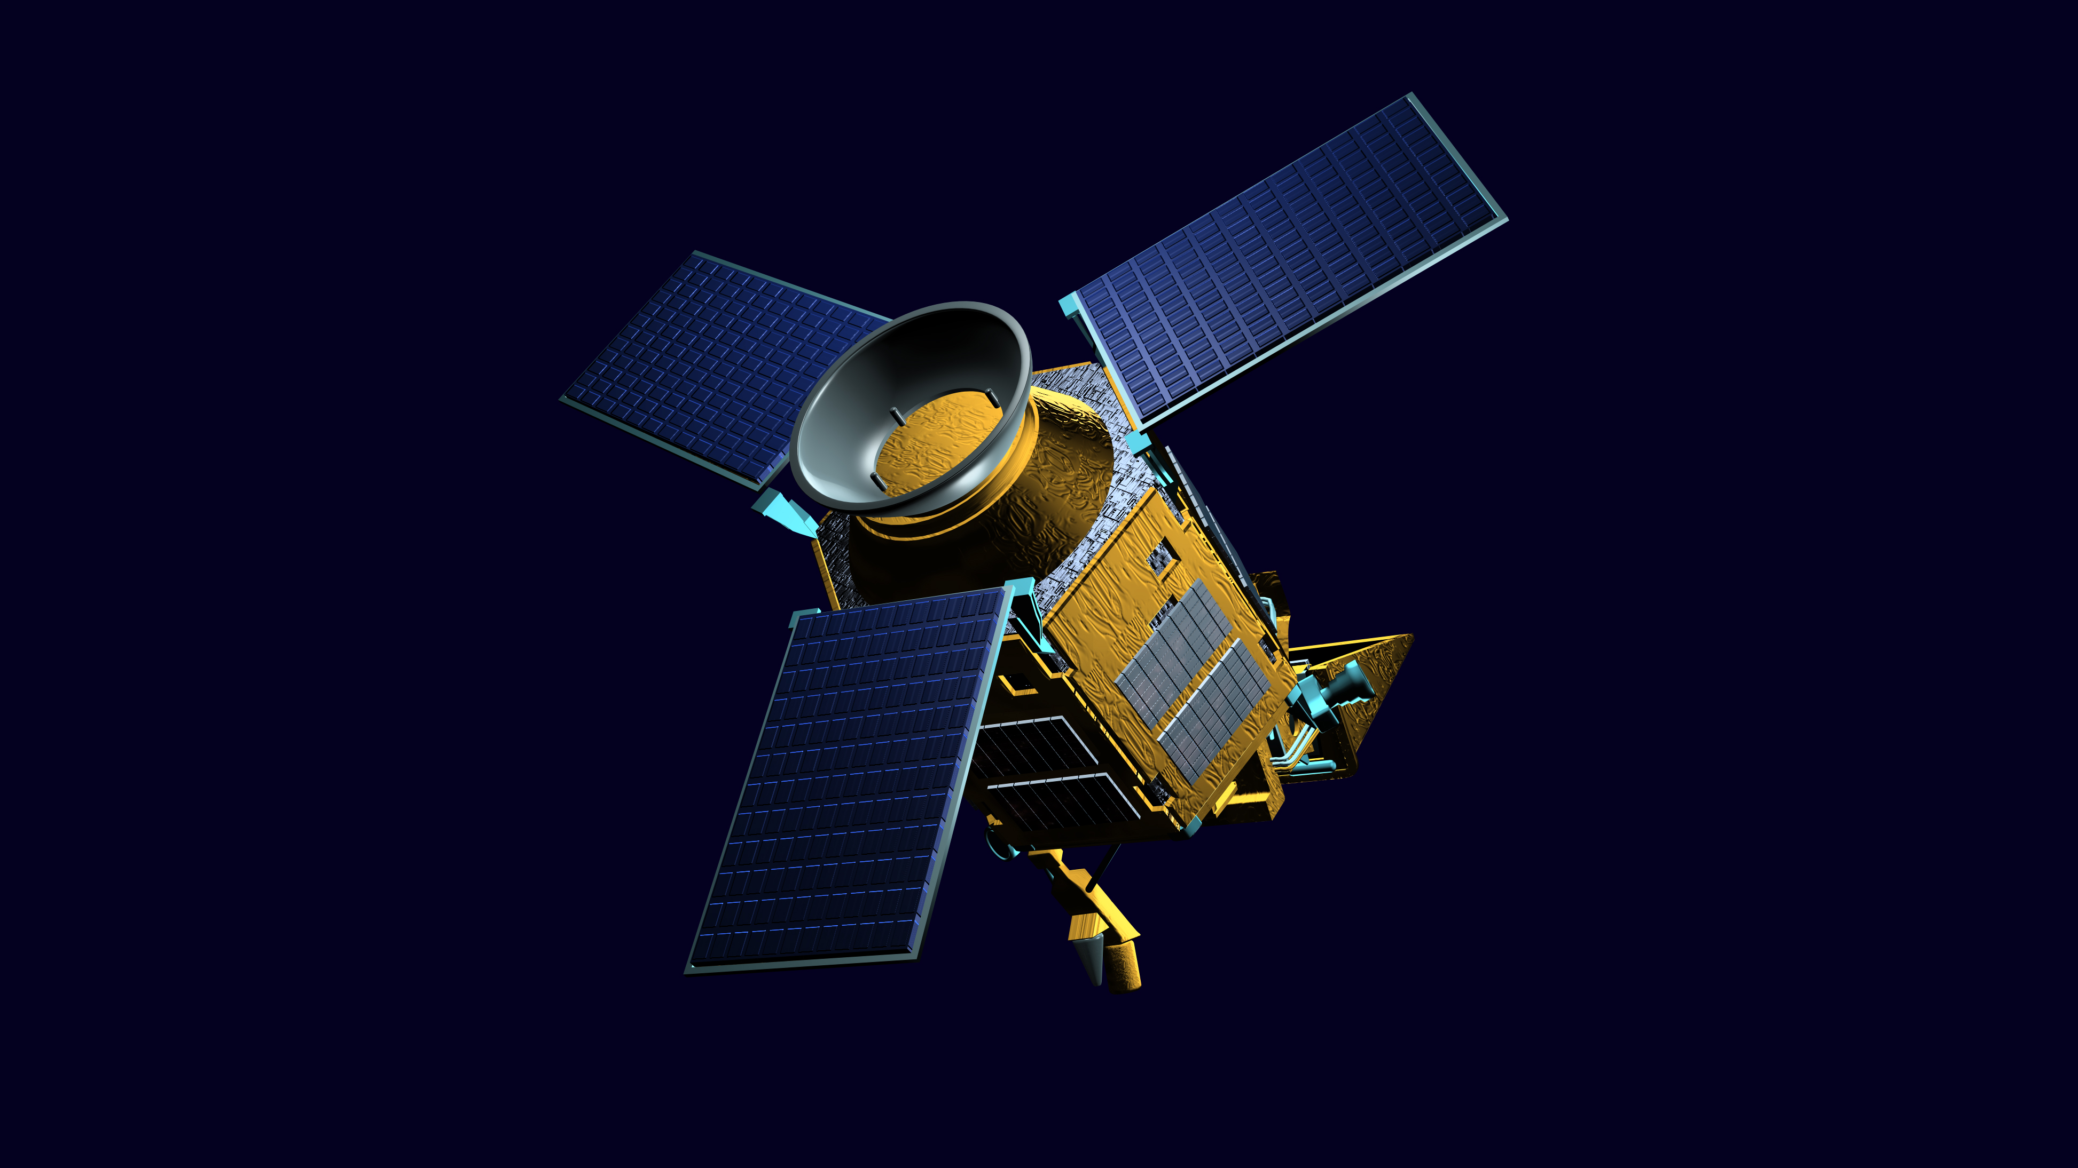
Tropomi
(TROPOspheric Monitoring Instrument)
Launched Oct. 2017,
Resolution (NO2)
2018-2019: 7 km
Since Oct. 2019: 5.5 km
Measurements: NO₂, O₃ (7km × 28km), SO₂, methane and CO
Souce [3]

Slide 9
Questions
How can we …
efficiently assimilate data from different data sources (measurements from different sensors and predictors with different resolutions)?
model the heterogeneities between areas (e.g. city, country)?
model the effects of road infrastructures (since station measurements are point data)?

Slide 10
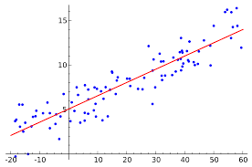




A preliminary study
Tree-based machine learning methods vs. Linear regression. With and without regularization
Global models Vs. National models
Temporally-resolved: Daytime Vs. Nighttime models

Slide 11
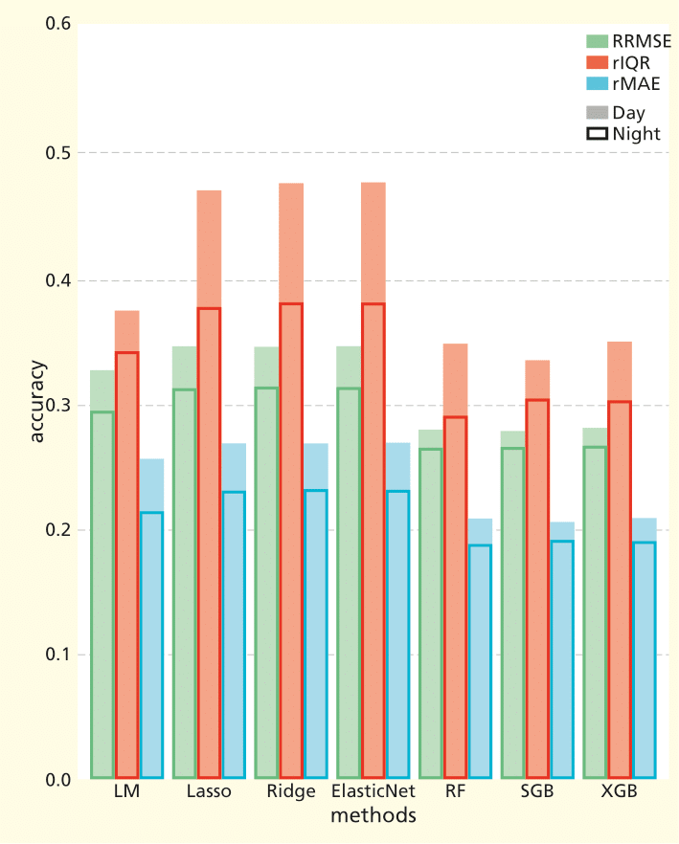
Regression Vs. tree-based methods
RRMSE: relative root mean squared error
rIQR: relative Interquartile range
rMAE: relative mean absolute error
LM: Multiple linear regression
RF: random forest
SGB: Stochastic gradient boosting
XGB: xgboost

Slide 12
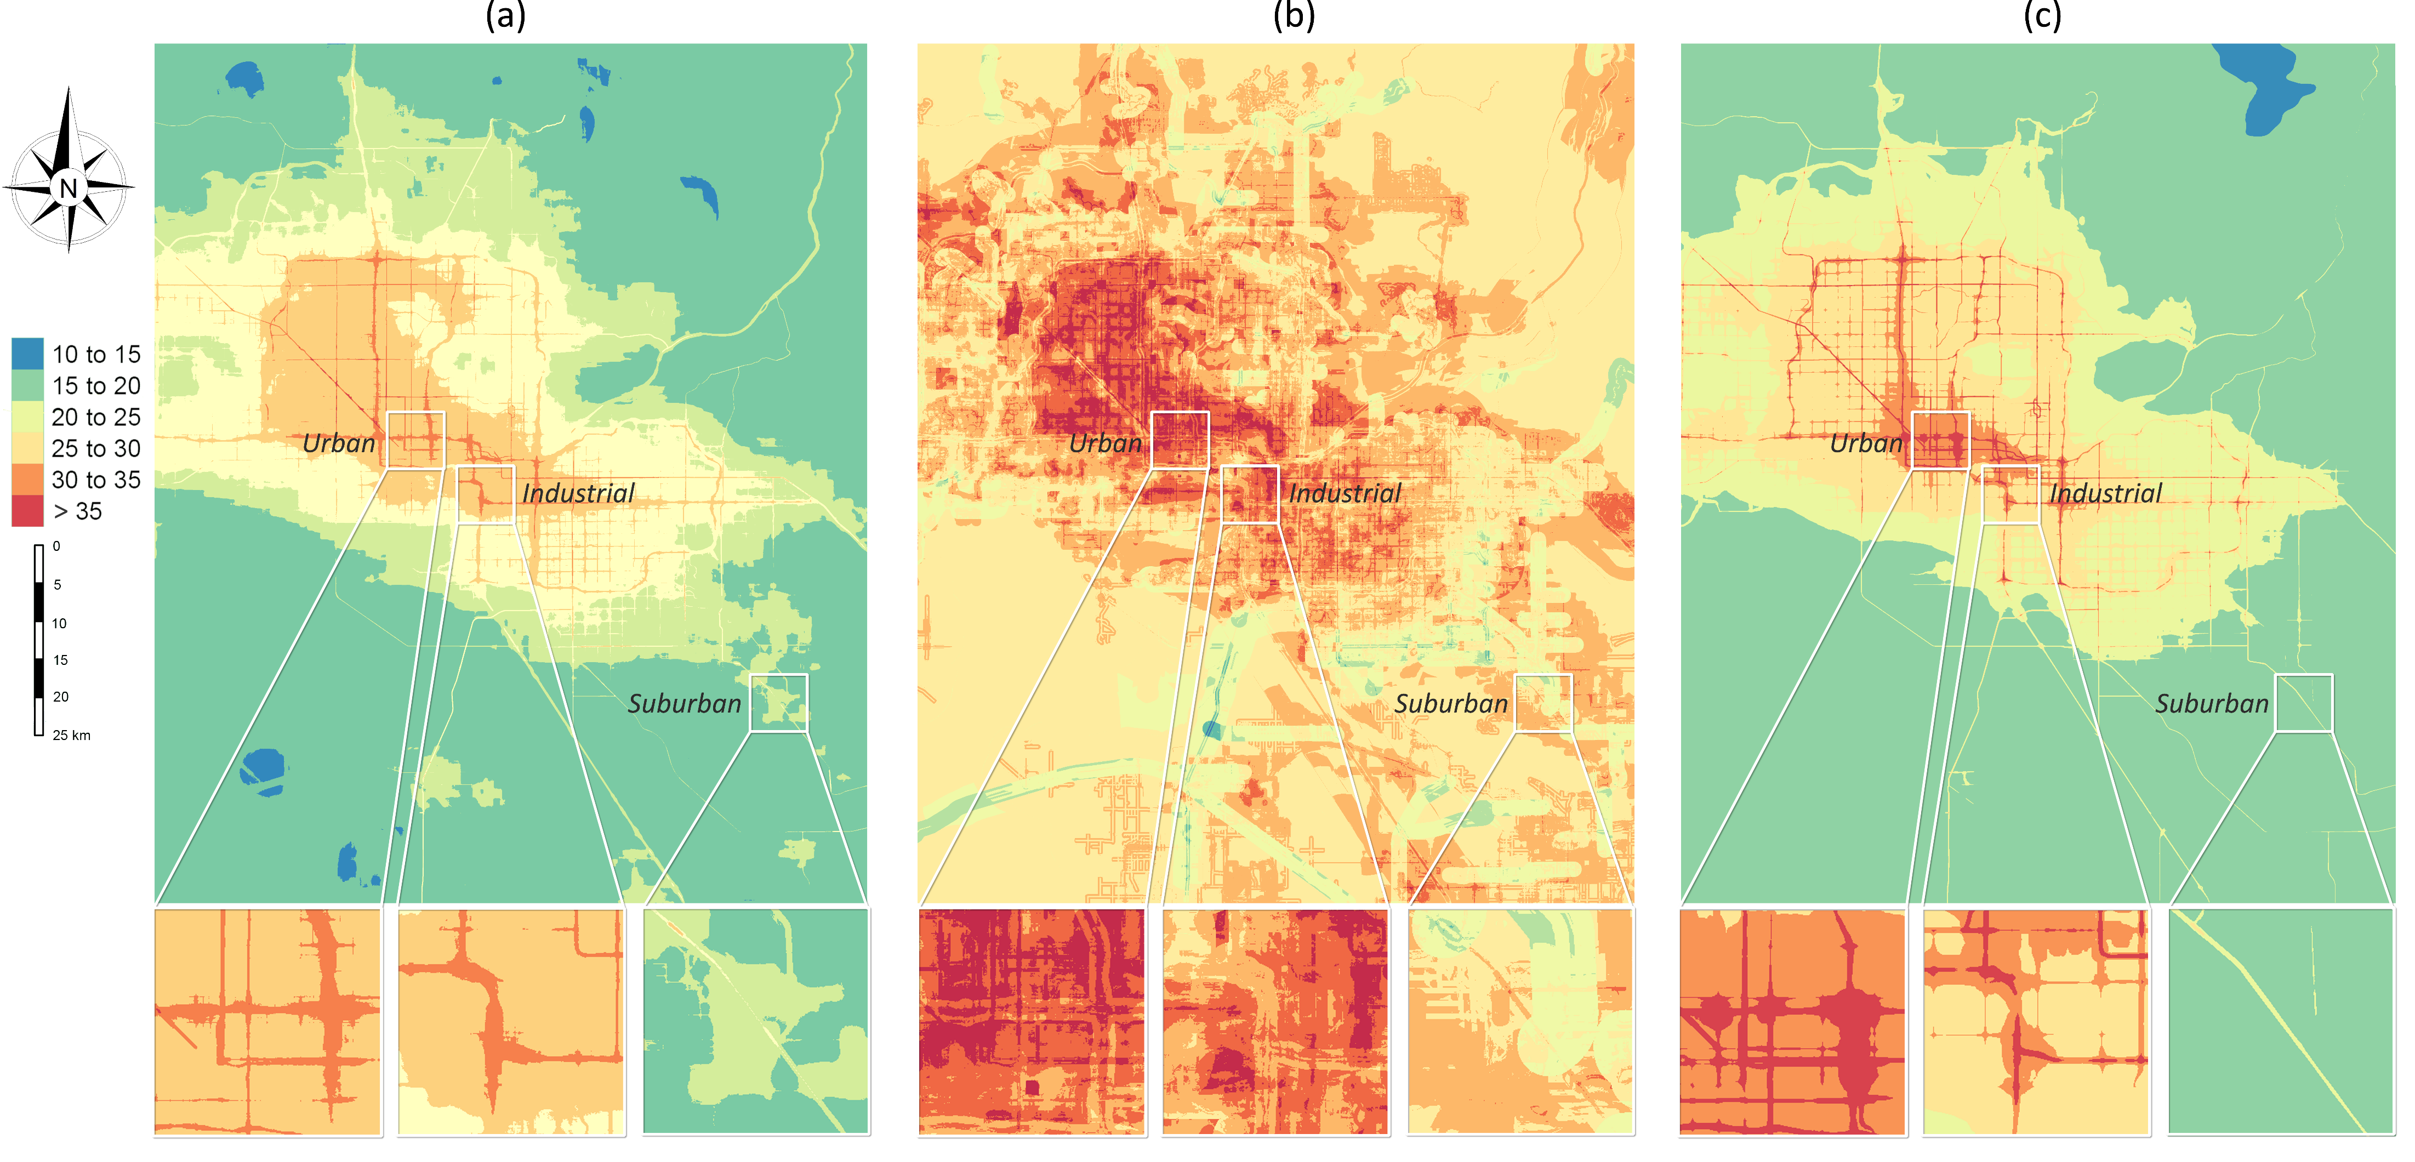
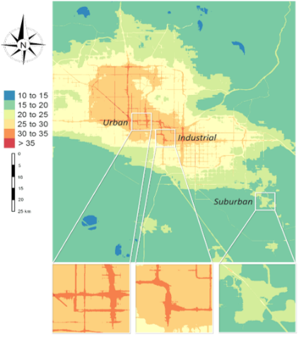


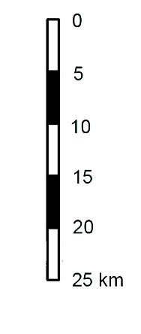

RF
LASSO
NO₂ (µg/$m^{3})$
Phoenix area, Arizona, USA

Slide 13
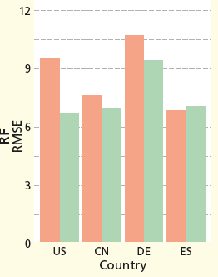
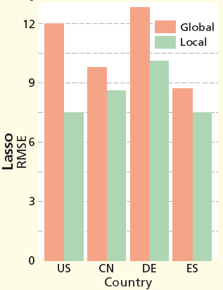
Global Vs. national models
CN: China
DE: Germany
ES: Spain
Conclusion: random forest is more suitable than Lasso for a global NO2 maping and using random forest can achieve an accuracy as good as national models.

Slide 14
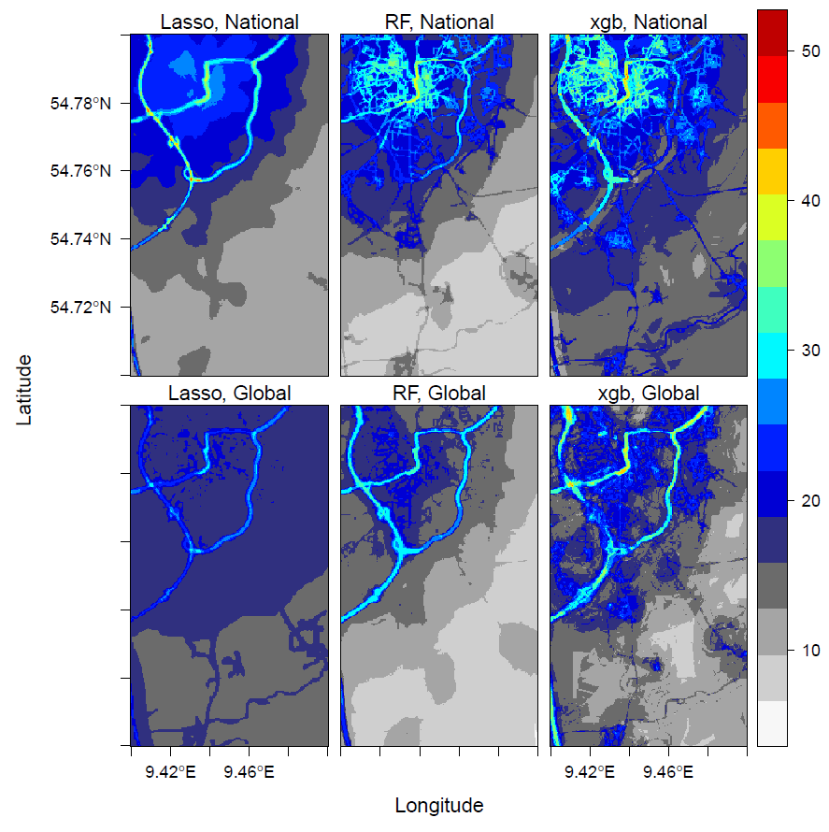
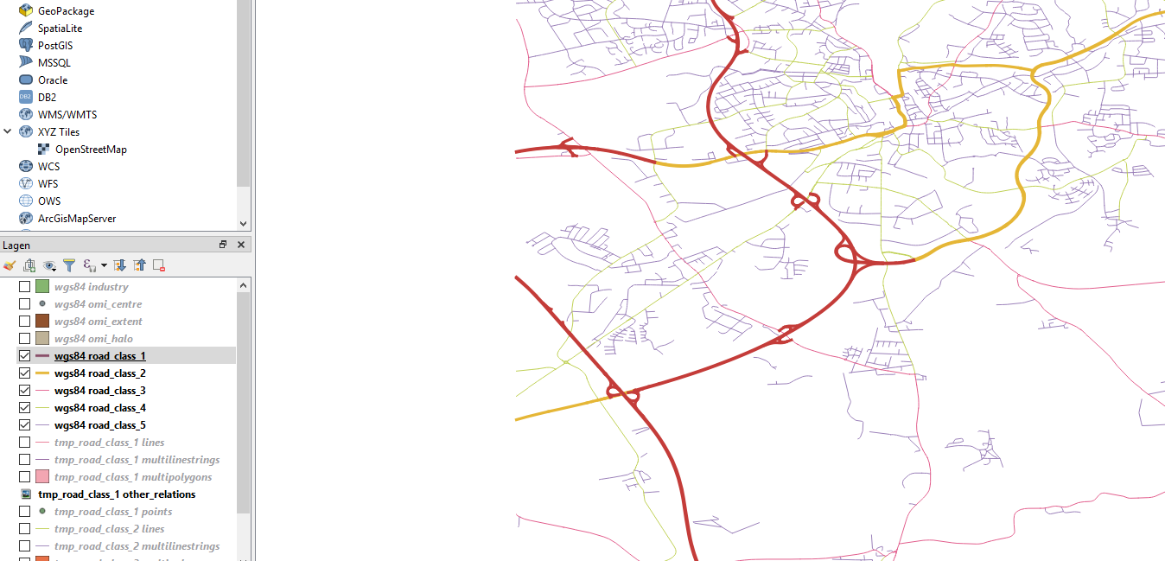
Germany
highway
primary

Slide 15
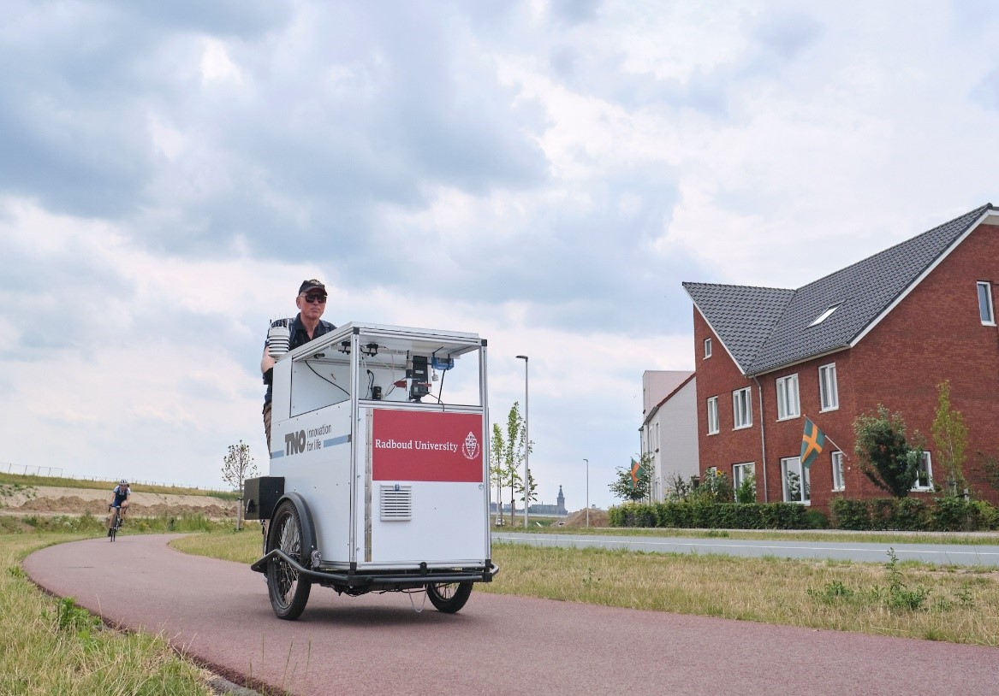
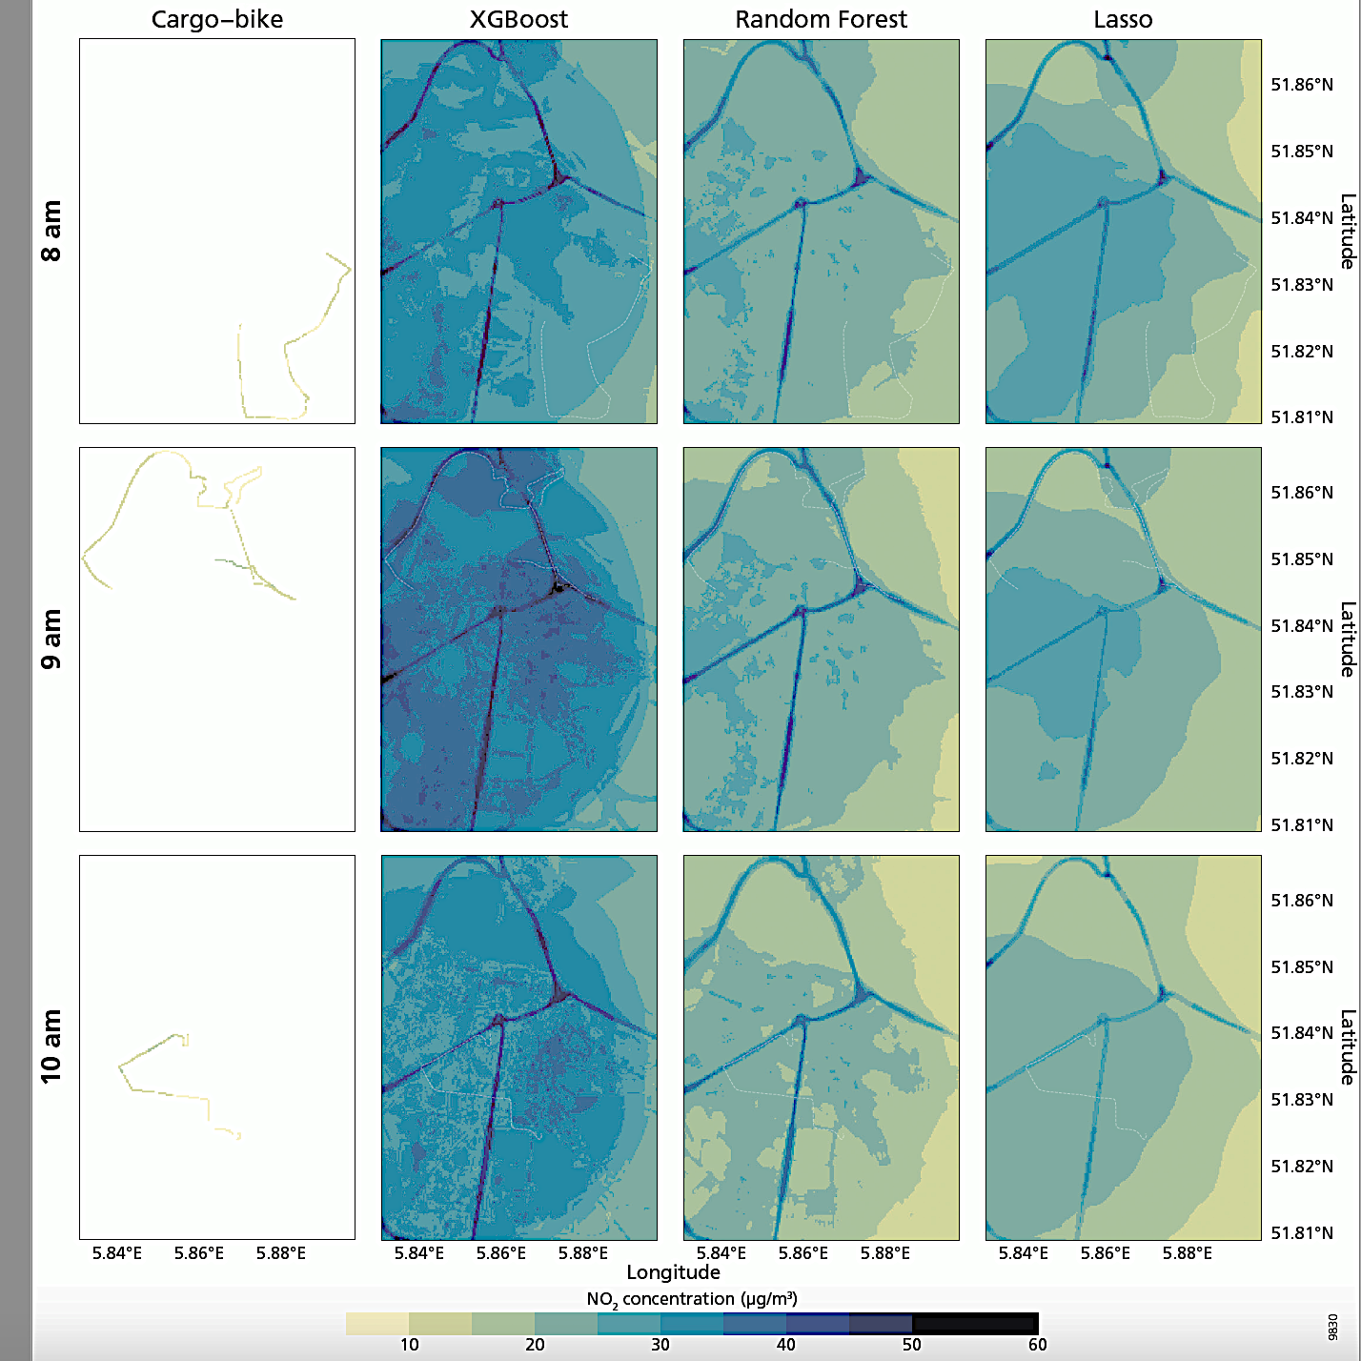
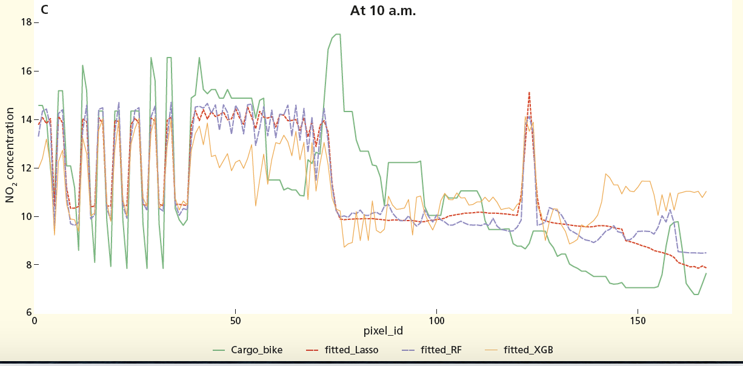
Further validation: cargo-bike measurements

Slide 16
Challenges
How can we better…
model the heterogeneities between areas (e.g. city, country)?
integrate data of different sources: measurements from different sensors and predictors with different resolutions?
model the effects of road infrastructures?
A more comprehensive comparison between different methods:
How can we account for spatial patterns when assessing the prediction accuracy?

Slide 17
In the workshop
Apollution mapping: more details about problems in global prediction
Statistical techniques:
Start:
Ensemble and boosting trees, SVG, ANN, ... → Regularization (ElasticNet, XGboost)
Tackle more of the challenges:
- Improvement of modelling process: Post-processing
Aggregating trees using regularized regression
- Hierarchical models:
Involving more spatial information and deal with different hierarchies:
Mixed-effect models, (Deep) convolutional NN (as in computer vision)
Comparison and relationships between techniques
Global modeling hands-on: Querying and processing OpenStreetMap, satellite and point data wrangling and exploration, hyperparameter tunning, validation, mapping.

Slide 18
Thank you
https://github.com/mengluchu/OpenGeoHub2020

Slide 19
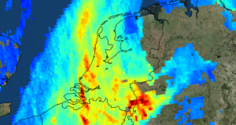
Tropomi
NO₂, O₃ (7km × 28km), SO₂, methane and CO
Electromagnetic field:
ultraviolet and visible (270–500 nm), near-infrared (675–775 nm), shortwave infrared (2305–2385 nm).
zoom in mode: 7 km × 3.5 km
5.5 km x 3.5 km since 2019

